Slide 1



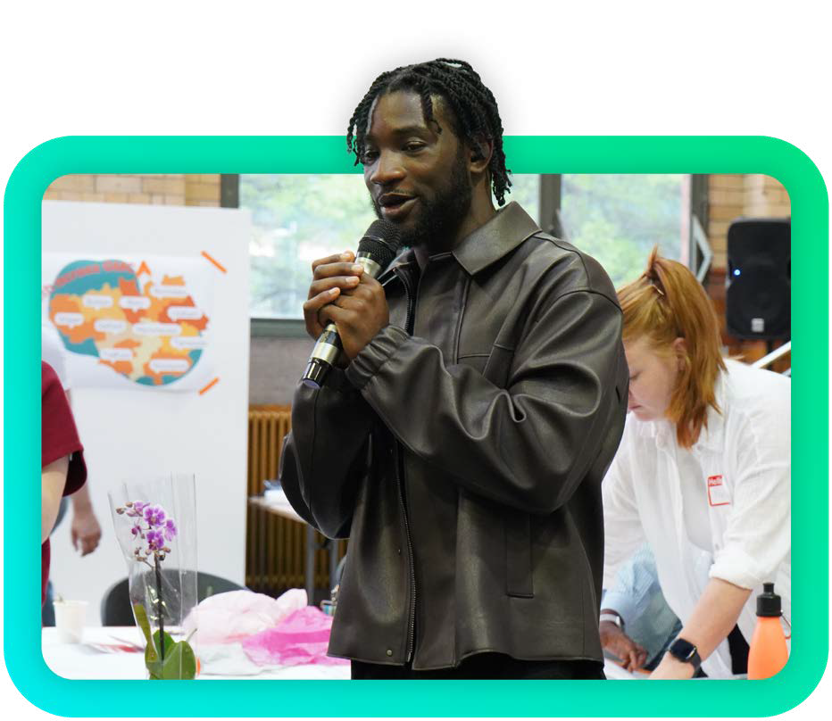
Making young voices heard!
Youth Democracy Workshop

Slide 2





Workshop Information
We want to hear from a wide range of young people, aged 10-21.
This will cover 4 themes:
  Democratic engagement
  Understanding Democracy
  Local Decision-making
  National Decision Making
Your views will be used to inform Government decisions on youth democracy programmes.

Slide 3



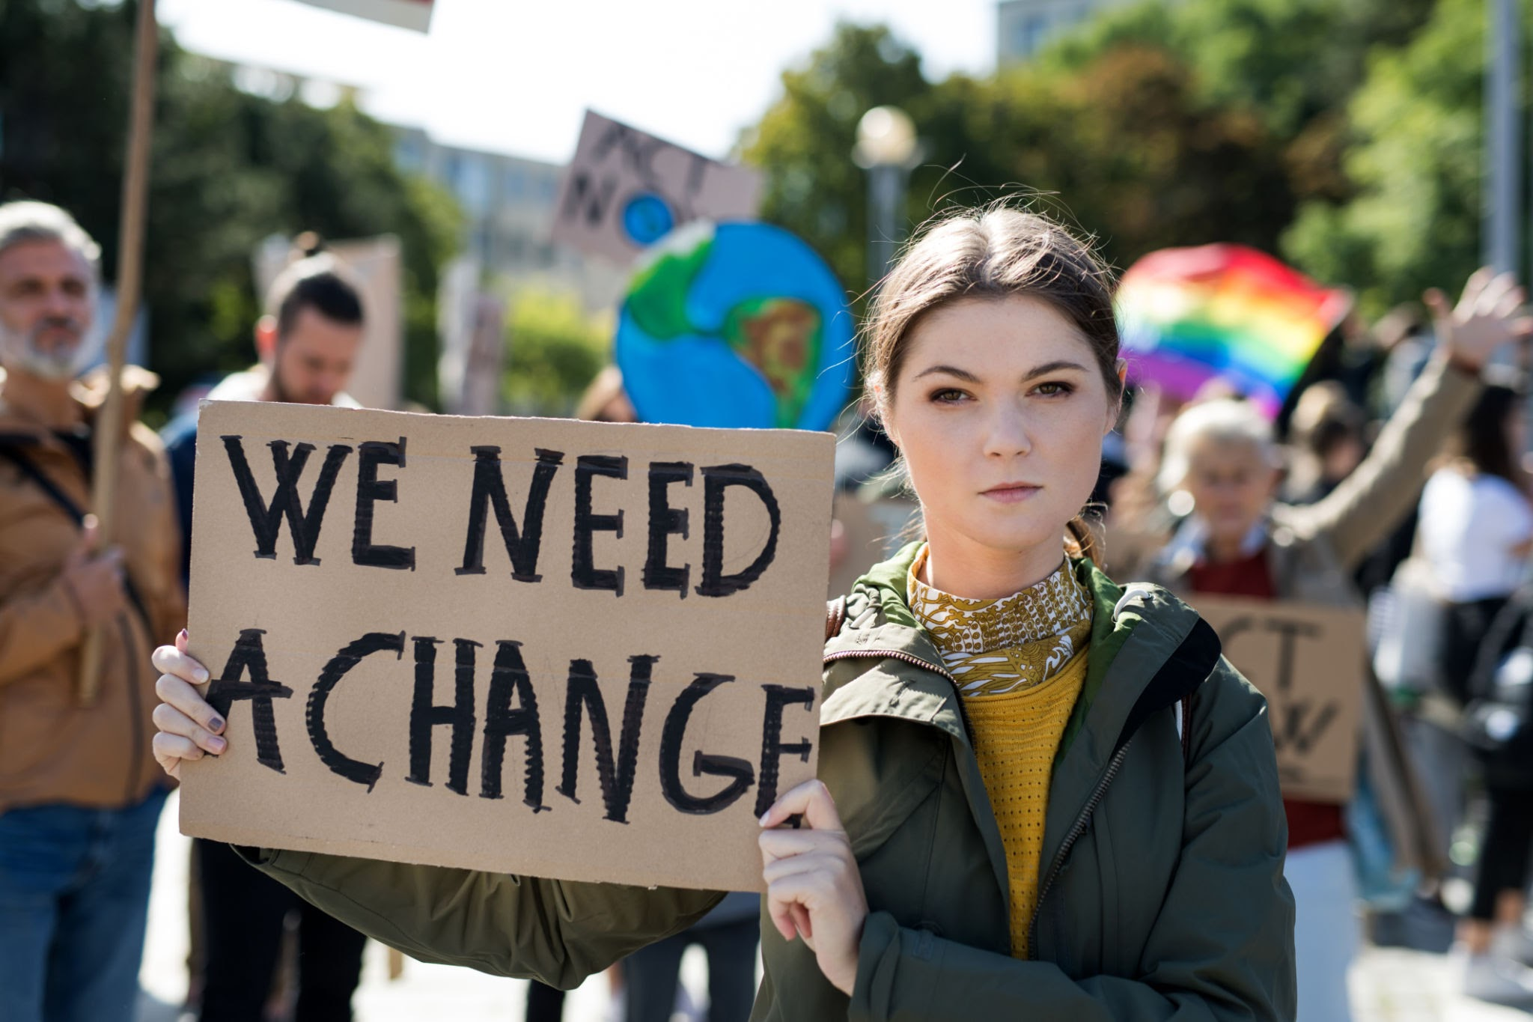
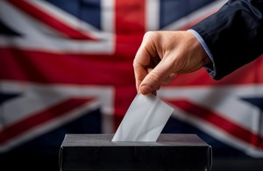
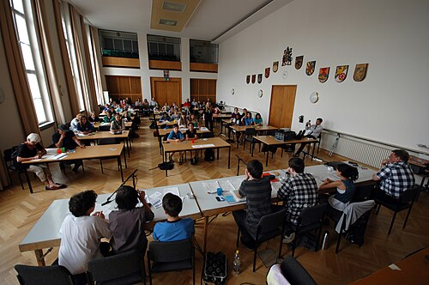
There are many ways young people can get involved in democracy.
Discussion: Currently do you get involved in democracy?
Volunteering
Youth Advisory Groups
Campaigning or joining a political party
Voting (The Government is lowering the voting age to 16 at the next election)
Youth Council
Notes:
Discussion: Do you get involved in democracy locally or nationally?
If yes, how?
If not, why not?

Slide 4


Many young people have told us they don’t feel confident taking part in democracy.
Discussion: What would help you to build confidence in taking part in democracy?
Learning more about how democracy works
Help to identify trustworthy information on politics
Who do you trust to give you support?

Slide 5
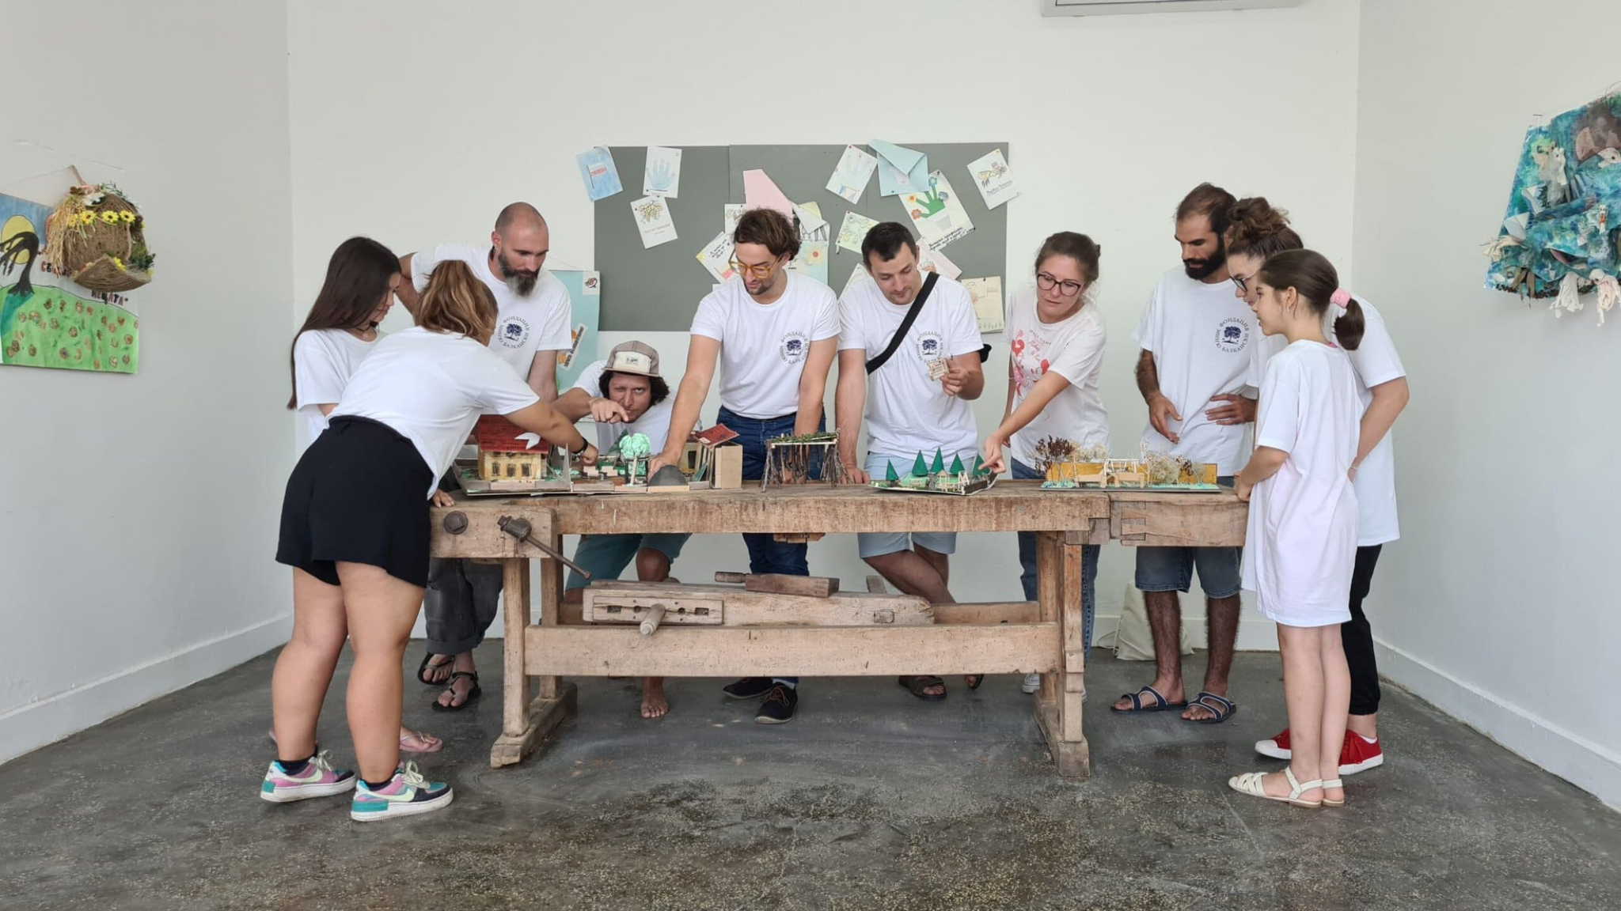
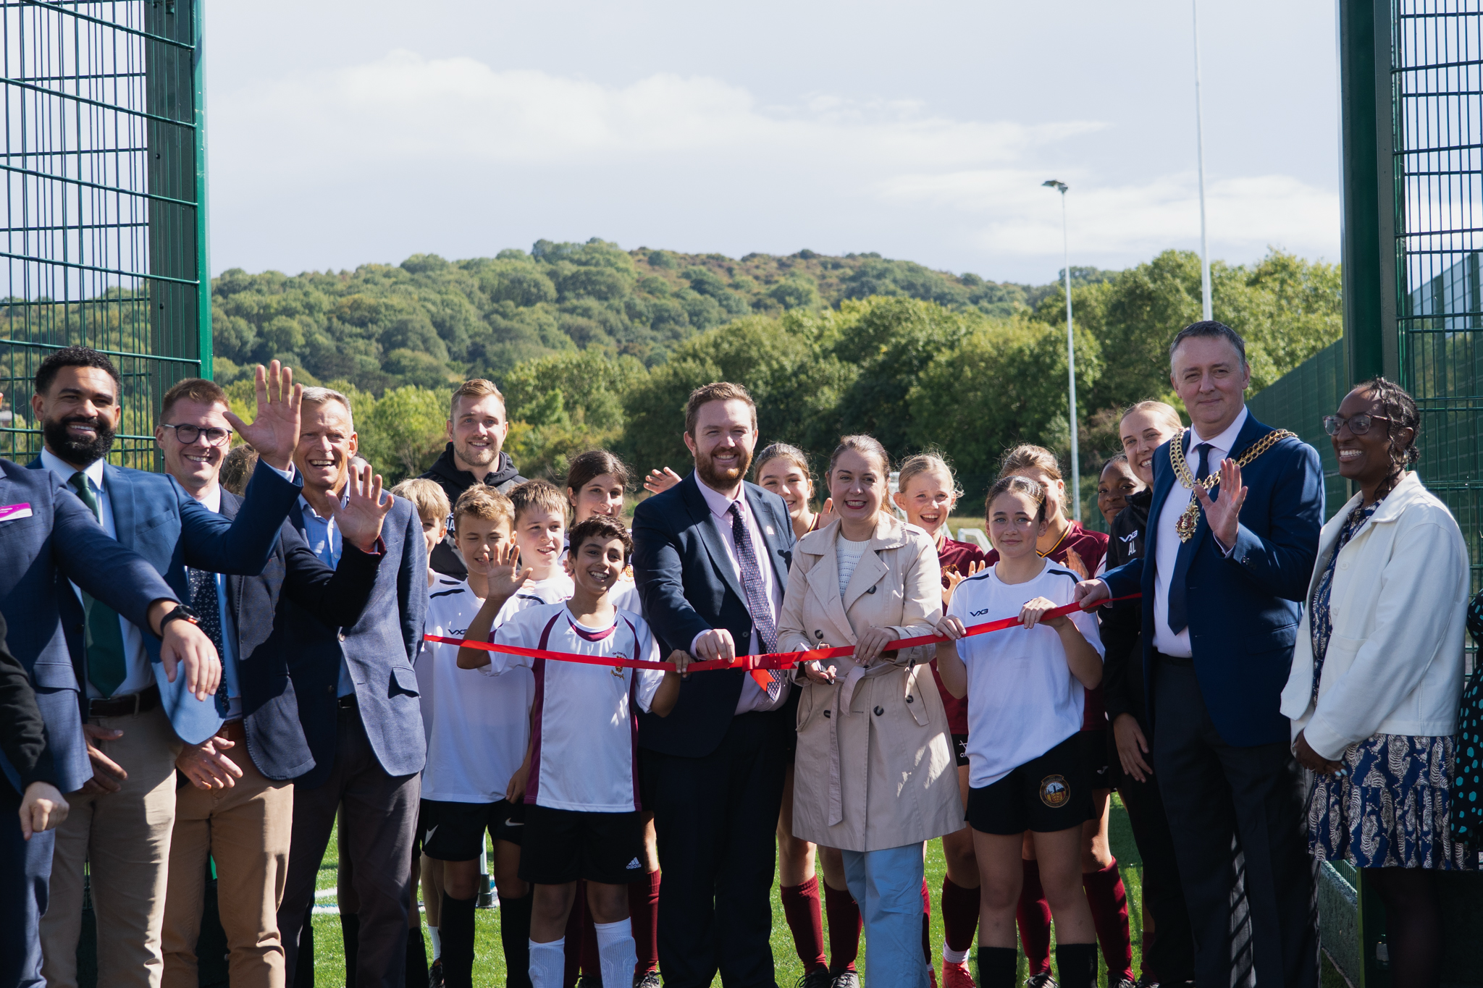

Young people have told us they want to be more involved in local decision making.
Discussion: What opportunities would you like to be available in your community?
More Local Youth Councils
Designing local community projects
More time talking to local politicians
More choice over how money is spent in your local areas

Slide 6
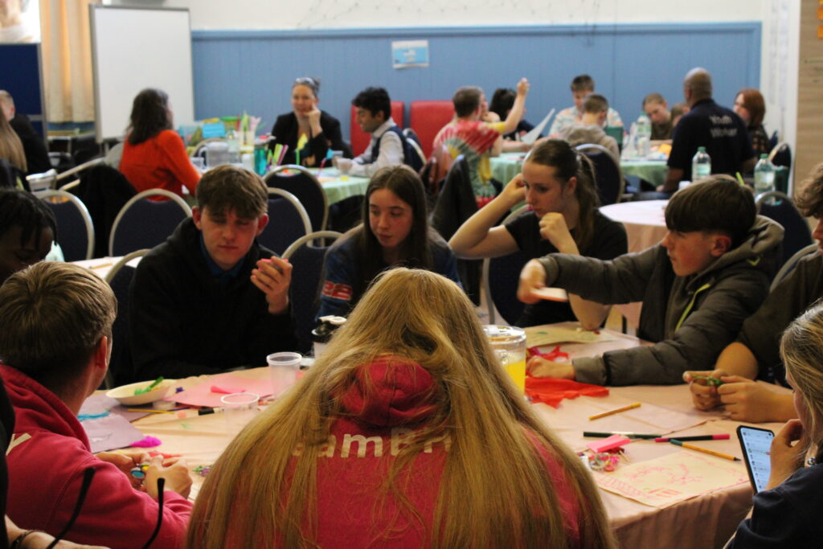

Young people have told us they want to be more involved in national decision making.
Discussion: How could national Government hear more from young people?
More workshops or feedback sessions
More National Youth Advisory Groups
Youth Mayors or Parliament
More online surveys
Notes:
Discussion: Do you get involved in democracy locally or nationally?
If yes, how?
If not, why not?

Slide 7
Thank you for taking part!
Please send your key themes, ideas and feedback to youth-be-seen-and-heard@dcms.gov.uk so they can inform Government decision making.
You can also share your views through this survey by 30 August 2026.
To keep up to date sign-up to the DCMS Youth Newsletter.
More information: Youth Matters: Your National Youth Strategy

Slide 8


